Slide 1
Introduction to Virtual Machines
Carl Waldspurger (SB SM ’89, PhD ’95), VMware R&D

Slide 2
Overview
Virtualization and VMs
Processor Virtualization
Memory Virtualization
I/O Virtualization (Omitted)
Resource Management

Slide 3
Types of Virtualization
Process Virtualization
Language-level Java, .NET, Smalltalk
OS-level processes, Solaris Zones, BSD Jails, Virtuozzo
Cross-ISA emulation Apple 68K-PPC-x86, Digital FX!32
Device Virtualization
Logical vs. physical VLAN, VPN, NPIV, LUN, RAID
System Virtualization
“Hosted” VMware Workstation, Microsoft VPC, Parallels
“Bare metal” VMware ESX, Xen, Microsoft Hyper-V
Notes:
Virtual systems
Abstract physical components/details using logical objects
Dynamically bind logical objects to physical configurations
This talk will be concentrating system virtualization.

Slide 4
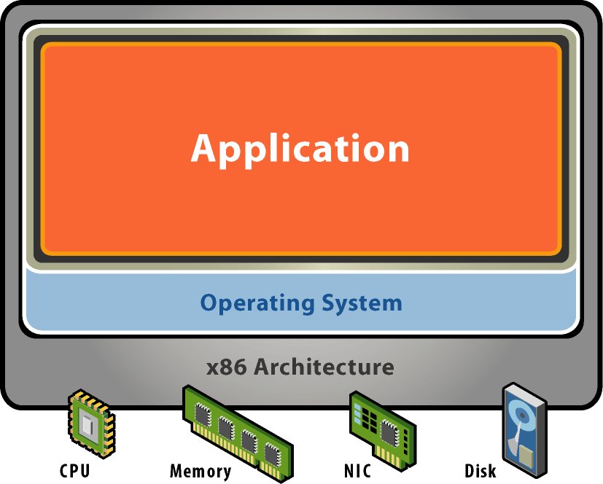
Starting Point: A Physical Machine
Physical Hardware
Processors, memory, chipset, I/O devices, etc.
Resources often grossly underutilized
Software
Tightly coupled to physical hardware
Single active OS instance
OS controls hardware

Slide 5
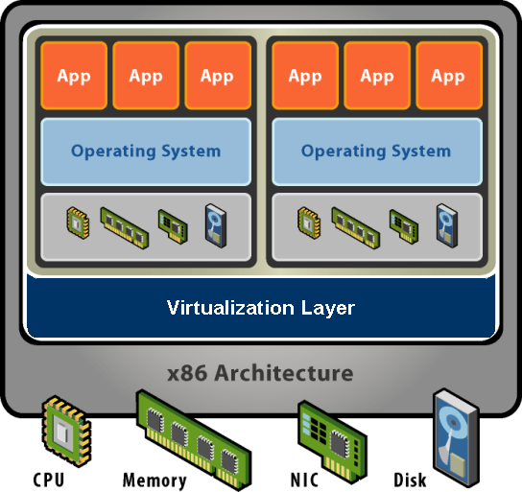
What is a Virtual Machine?
Software Abstraction
Behaves like hardware
Encapsulates all OS and application state
Virtualization Layer
Extra level of indirection
Decouples hardware, OS
Enforces isolation
Multiplexes physical hardware across VMs
Notes:
Virtualization can be defined many ways. I will try to define it formally and also define it by giving a few examples. However loosely, virtualization is the addition of a software layer (the virtual machine monitor) between the hardware and the existing software that exports an interface at the same level as the underlying hardware.
In the strictest case the exported interface is the exact same as the underlying hardware and the virtual machine monitor provides no functionality except multiplexing the hardware among multiple VMs. This was largely the case in the old IBM VM/360 systems.
However the layer really can export a different hardware interface as the case in cross-ISA emulators. Also the layer can provide additional functionality not present in the operating system.
I think of virtualization as the addition of a layer of software that can run the original software with little or no changes.

Slide 6
Virtualization Properties
Isolation
Fault isolation
Performance isolation
Encapsulation
Cleanly capture all VM state
Enables VM snapshots, clones
Portability
Independent of physical hardware
Enables migration of live, running VMs
Interposition
Transformations on instructions, memory, I/O
Enables transparent resource overcommitment, encryption, compression, replication …
Notes:
Virtualization has three main properties that give rise to all its applications.
Isolation
First, virtualization provides isolation. Isolation is key for many applications and comes in several flavors.
Fault Isolation. If one virtual machine contains a buggy operating system, that OS can start scribbling all over physical memory. These wild rights must be contained within the VM boundaries.
Performance Isolation. Ideally VMs performance would be independent of the activity going-on on the hardware. This must be accomplished by smart scheduling and resource allocation policies in the monitor.
Software Isolation. Most of the issues with computers today are complex software configurations. DLL hell on PCs, operating system and library versions, viruses, and other security threats. VMs are naturally isolated for each other by running in separate software environments.
Encapsulation
Encapsulation is the property that all VM state can be described and recorded simply. The VM state is basically the dynamic memory, static memory, and the register state of the CPU and devices. These items typically have a simple layout and are easy to describe. We can checkpoint a VM by writing out these items to a few files. The VM can be moved and copied by moving these files around. You can think about this as similar to doing a backup at the block level vs. doing a backup by recording all the packages, configuration and data files that encompass a file system.
Interposition
At some level all access to the hardware passes through the monitor first. This gives the monitor and chance to operate on these accesses. The best example of this is encrypting all data written to a disk. The advantage of this is that it does it without the knowledge of the OS.
Why not in the OS?
This brings up a good point. Why not do these things in the OS. By splitting up the system this way the OS functions more like a large application library. The VMM functions more like a smart set of device drivers. This is a nice split and can simplify overall system design. It also provides a natural administration boundary. However the monitor is often at a disadvantage because it does not have the same insight into what’s happening as the OS has. For example, the OS knows the distinction between data and metadata when implementing an encrypted file system. So there is a tradeoff there.

Slide 7
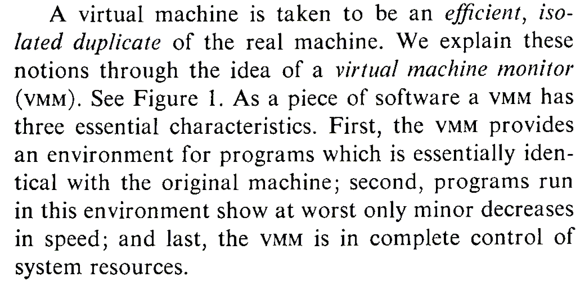
What is a Virtual Machine Monitor?
Classic Definition (Popek and Goldberg ’74)
VMM Properties
Fidelity
Performance
Safety and Isolation

Slide 8
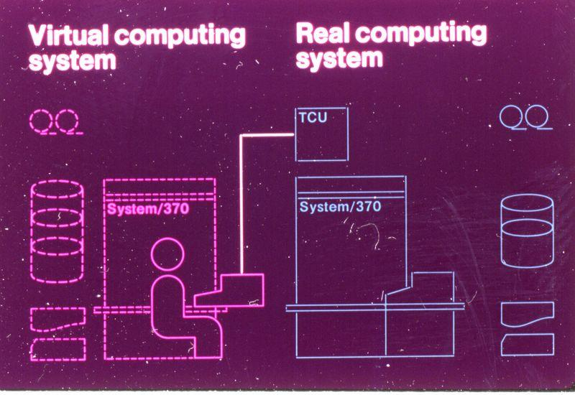
Classic Virtualization and Applications
Classical VMM
IBM mainframes: IBM S/360, IBM VM/370
Co-designed proprietary hardware, OS, VMM
“Trap and emulate” model
Applications
Timeshare several single-user OS instances on expensive hardware
Compatibility
From IBM VM/370 product announcement, ca. 1972

Slide 9
Modern Virtualization Renaissance
Recent Proliferation of VMs
Considered exotic mainframe technology in 90s
Now pervasive in datacenters and clouds
Huge commercial success
Why?
Introduction on commodity x86 hardware
Ability to “do more with less” saves $$$
Innovative new capabilities
Extremely versatile technology

Slide 10
Modern Virtualization Applications
Server Consolidation
Convert underutilized servers to VMs
Significant cost savings (equipment, space, power)
Increasingly used for virtual desktops
Simplified Management
Datacenter provisioning and monitoring
Dynamic load balancing
Improved Availability
Automatic restart
Fault tolerance
Disaster recovery
Test and Development

Slide 11
Representative Products
VM (IBM), very early, roots in System/360, ’64 –’65
Bochs, open source emulator.
Xen, open source VMM, requires changes to guest OS.
SIMICS, full system simulator
VirtualPC (Microsoft)

Slide 12
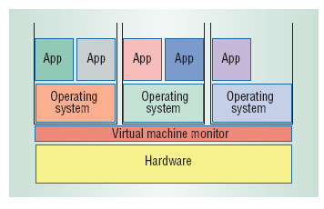
Virtual Machine Monitors (VMMs)
Virtual machine monitor (VMM) or hypervisor is software that supports VMs
VMM determines how to map virtual resources to physical resources
Physical resource may be time-shared, partitioned, or emulated in software
VMM is much smaller than a traditional OS;
isolation portion of a VMM is ≈ 10,000 lines of code

Slide 13
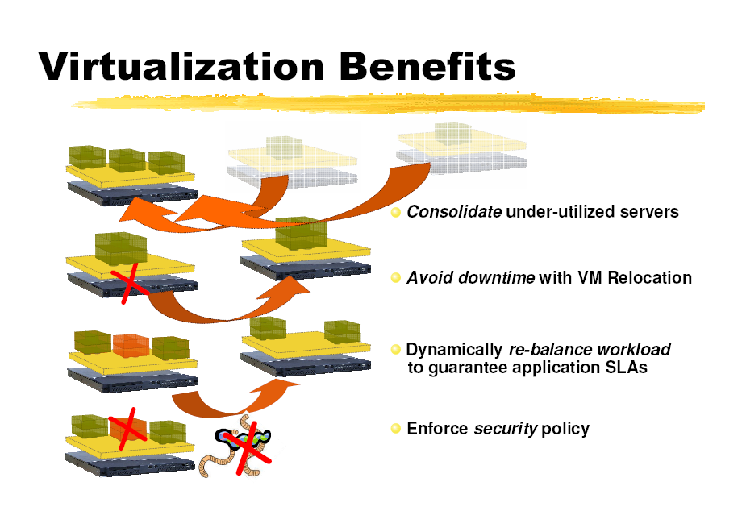
Virtual Machine Monitors (VMMs)

Slide 14
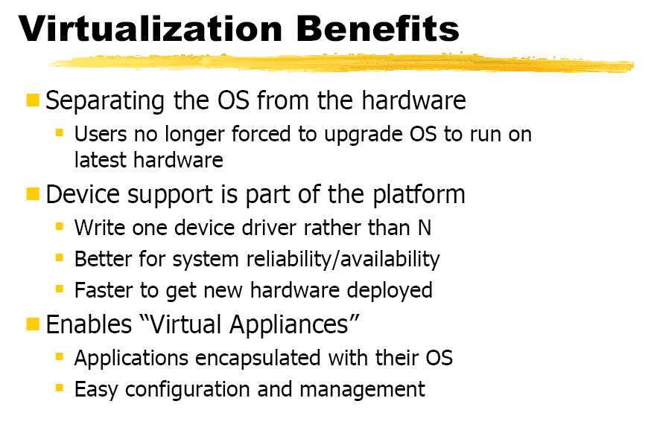
Virtual Machine Monitors (VMMs)

Slide 15
Abstraction, Virtualization of Computer System
Modern computer system is very complex
Hundreds of millions of transisters
Interconnected high-speed I/O devices
Networking infrastructures
Operating systems, libraries, applications
Graphics and networking softwares
To manage this complexity
Levels of Abstractions
seperated by well-defined interfaces
Virtualizations

Slide 16
Abstraction, Virtualization of Computer System
Virtualization
Applications or OS
Application uses virtual disk as Real disk
Virtualized
Disk
Virtualization
File
File
Abstraction
Real Disk

Slide 17
Architecture, Implementation Layers
Architecture
Functionality and Appearance of a computer system but not implementation details
Level of Abstraction = Implementation layer
ISA, ABI, API
Application
Programs
Libraries
ABI
Operating System
Drivers
Memory
Manager
Scheduler
API
ISA
Execution Hardware
Memory
Translation
System Interconnect (Bus)
Controllers
Controllers
IO Devices,
Networking
Main Memory

Slide 18
Architecture, Implementation Layers
Implementation Layer : ISA
Instruction Set Architecture
Divides hardware and software
Concept of ISA originates from IBM 360
IBM System/360 Model (20, 40, 30, 50, 60, 62, 70, 92, 44, 57, 65, 67, 75, 91, 25, 85, 95, 195, 22) : 1964~1971
Various prices, processing power, processing unit, devices
But guarantee a software compatibility
User ISA and System ISA

Slide 19
Architecture, Implementation Layers
Implementation Layer : ABI
Application Binary Interface
Provides a program with access to the hardware resource and services available in a system
Consists of User ISA and System Call Interfaces

Slide 20
Architecture, Implementation Layers
Implementation Layer : API
Application Programming Interface
Key element is Standard Library ( or Libraries )
Typically defined at the source code level of High Level Language
clib in Unix environment : supports the UNIX/C programming language

Slide 21
What is a VM and Where is the VM?
What is “Machine”?
2 perspectives
From the perspective of a process
ABI provides interface between process and machine
From the perspective of a system
Underlying hardware itself is a machine.
ISA provides interface between system and machine

Slide 22
What is a VM and Where is the VM?
Machine from the perspective of a process
ABI provides interface between process and machine
Application Software
Application
Programs
Libraries
System calls
Operating System
Drivers
Memory
Manager
Scheduler
User ISA
Execution Hardware
ABI
Memory
Translation
Machine
System Interconnect (Bus)
Controllers
Controllers
IO Devices,
Networking
Main Memory

Slide 23
What is a VM and Where is the VM?
Machine from the perspective of a system
ISA provides interface between system and machine
Application Software
Application
Programs
Libraries
Operating System
Operating System
Drivers
Memory
Manager
Scheduler
System ISA
User ISA
Execution Hardware
ISA
Memory
Translation
Machine
System Interconnect (Bus)
Controllers
Controllers
IO Devices,
Networking
Main Memory

Slide 24
What is a VM and Where is the VM?
Virtual Machine is a Machine.
VM virtualizes Machine Itself!
There are 2 types of VM
Process-level VM
System-level VM
VM is implemented as combination of
Real hardware
Virtualizing software

Slide 25
What is a VM and Where is the VM?
Process VM
VM is just a process from the view of host OS
Application on the VM cannot see the host OS
Application Process
Guest
Application Software
Virtualizing
Software
Virtual
Machine
System calls
System calls
Runtime
ABI
OS
User ISA
User ISA
ABI
Machine
Host
Hardware

Slide 26
What is a VM and Where is the VM?
System VM
Provides a system environment
Application Software
Applications
Guest
Operating System
OS
Virtualizing
Software
Virtual
Machine
Runtime
System ISA
User ISA
ISA
Machine
Host
Hardware

Slide 27
What is a VM and Where is the VM?
System VM
Example of a System VM as a process
VMWare
Applications
Other Host Applications
Guest OS
Virtualizing
Software (VMWare)
Host OS
Hardware

Slide 28
VMM Overhead?
Depends on the workload
User-level processor-bound programs (e.g., SPEC) have zero-virtualization overhead
Runs at native speeds since OS rarely invoked
I/O-intensive workloads ⇒ OS-intensive ⇒ execute many system calls and privileged instructions ⇒ can result in high virtualization overhead
For System VMs, goal of architecture and VMM is to run almost all instructions directly on native hardware
If I/O-intensive workload is also I/O-bound ⇒ low processor utilization since waiting for I/O ⇒ processor virtualization can be hidden ⇒ low virtualization overhead

Slide 29
Requirements of a Virtual Machine Monitor
A VM Monitor
Presents a SW interface to guest software,
Isolates state of guests from each other, and
Protects itself from guest software (including guest OSes)
Guest software should behave on a VM exactly as if running on the native HW
Except for performance-related behavior or limitations of fixed resources shared by multiple VMs
Guest software should not be able to change allocation of real system resources directly
Hence, VMM must control ≈ everything even though guest VM and OS currently running is temporarily using them
Access to privileged state, Address translation, I/O, Exceptions and Interrupts, …

Slide 30
Requirements of a Virtual Machine Monitor
VMM must be at higher privilege level than guest VM, which generally run in user mode
Execution of privileged instructions handled by VMM
E.g., Timer interrupt: VMM suspends currently running guest VM, saves its state, handles interrupt, determine which guest VM to run next, and then load its state
Guest VMs that rely on timer interrupt provided with virtual timer and an emulated timer interrupt by VMM
Requirements of system virtual machines are ≈ same as paged-virtual memory:
At least 2 processor modes, system and user
Privileged subset of instructions available only in system mode, trap if executed in user mode
All system resources controllable only via these instructions

Slide 31
Overview
Virtualization and VMs
Processor Virtualization
Memory Virtualization
I/O Virtualization
Resource Management

Slide 32
Processor Virtualization
Trap and Emulate
Binary Translation

Slide 33
Trap and Emulate
Guest OS + Applications
Unprivileged
Page
Fault
Undef
Instr
vIRQ
Virtual Machine Monitor
Privileged
MMU
Emulation
CPU
Emulation
I/O
Emulation
Notes:
Direct execution

Slide 34
“Strictly Virtualizable”
A processor or mode of a processor is strictly virtualizable if, when executed in a lesser privileged mode:
all instructions that access privileged state trap
all instructions either trap or execute identically
Notes:
Again another operational definition. This idea behind strictly virtualizable is the whether trap and emulate will work.
The x86 is not strictly virtualizable. One reason is the popf instruction. popf takes a word off the stack and puts in into the flags register. One flag in that register is the interrupt enable flag. At system level the flag is updated by popf. When the designers of the x86 introduced user mode they realized that modifications of this flag by the user would break the OS. So they solved this by silently dropping updates to the IF at user level. This works for OS’s put breaks VMMs. When a VMM runs the OS by boosting it into user level all modifications the OS make to the IF are silently dropped and the VMM looses track of whether the OS whats interrupts to be enabled or disabled. The way to do this would be to make popf trap, or better yet make popf’s that modify IF to trap.
Note that these conditions are necessary but not sufficient. For example on the x86 there are several other reasons why trap and emulate will not work.

Slide 35
Issues with Trap and Emulate
Not all architectures support it
Trap costs may be high
VMM consumes a privilege level
Need to virtualize the protection levels

Slide 36
Binary Translation
Guest Code
Translation Cache
vEPC
mov ebx, eax
mov ebx, eax
start
cli
mov [VIF], 0
and ebx, ~0xfff
and ebx, ~0xfff
mov ebx, cr3
mov [CO_ARG], ebx
sti
call HANDLE_CR3
ret
mov [VIF], 1
test [INT_PEND], 1
jne
call HANDLE_INTS
jmp HANDLE_RET
Notes:
Dynamic binary translation is used in virtualizing the CPU by translating potentially dangerous (or non-virtualizable) instruction sequences one-by-one into safe instruction sequences.
It works like this:
The monitor inspects the next sequence of instructions. An instruction sequence is typically defined as the next basic block, that is all instructions up to the next control transfer instruction such as a branch. There may be reasons to end a sequence earlier or go past a branch but for now lets assume we go to the next branch.
Each instruction is translated and the translation is copied into a translation cache.
Instructions are translated as follows:
Instructions which pose no problems can be copied into the translation cache with modification. We call these “ident” translations.
Some simple dangerous instructions can be translated into a short sequence emulation code. This code is placed directly into the translation cache. We call this “inline” translation. An example is the modification of the Interrupt Enable flag.
Other dangerous instructions need be performed by emulation code in the monitor. For these instructions calls to the monitor are made. These are called “Call-outs”. An example of these is a change to the page table base.
The branch ending the basic block needs a call out.
The monitor can now jump to the start of the translated basic block with the virtual registers in the hardware registers.
So dangerous instructions can be privileged instructions, non-virtualizable instructions, control flow, memory accesses.

Slide 37
Issues with Binary Translation
Translation cache management
PC synchronization on interrupts
Self-modifying code
Notified on writes to translated guest code
Protecting VMM from guest

Slide 38
Overview
Virtualization and VMs
Processor Virtualization
Memory Virtualization
I/O Virtualization
Resource Management

Slide 39
Memory Virtualization
Guest OS needs to see a zero-based memory space
Terms:
Machine address -> Host hardware memory space
“Physical” address -> Virtual machine memory space

Slide 40
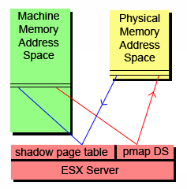
Memory Virtualization
Translation from MPN (machine page numbers) to PPN (physical page numbers) is done thru a pmap data structure for each VM
Shadow page tables are maintained for virtual-to-machine translations
Allows for fast direct VM to Host address translations
Easy remapping of PPN-to-MPN possible transparent to VM

Slide 41
Memory Virtualization
Shadow Page Tables
Nested Page Tables

Slide 42
Traditional Address Spaces
0
4GB
Virtual Address Space
0
4GB
Physical Address Space
Notes:
In a traditional system there are typically 2 address spaces – the virtual address space (VAS) and the physical address space (PAS). The OS and user processes run in the VAS. The OS manages the mapping from VAS to PAS through the use of the Memory Management Unit (MMU) provided in the processor. The OS maintains a page table that maps each page in the current VAS to a page in the PAS. Typically the OS will maintain one page table per user level process.

Slide 43
Traditional Address Translation
Virtual Address
TLB
Physical Address
₁
₄
₂
₅
₃
Operating System’s
Page Fault Handler
Process
Page Table
₂
Notes:
Lets follow the path when the required mapping is not in the TLB.
There is a miss in the TLB. The hardware will walk the current process’s page table to find the mapping. The page table structure will probably be more complicated than I’m showing here.
One of two things can happen:
The required mapping is found in the page table and placed in the TLB. The instruction is restarted and all proceeds normally. Note that in this case the hardware does all the work.
The required mapping is not present. An page fault exception is generated by the hardware and trapped into the operating system. The OS will do what it does to figure out the correct mapping.
The new translation is put into the current process’s page table.
The OS resume’s execution at the faulting nstruction. Now the hardware TLB refill mechanism will work.
The hardware put the new mapping in the TLB and life goes on.

Slide 44
Virtualized Address Spaces
0
4GB
Virtual Address Space
Guest Page Table
0
4GB
Physical Address Space
VMM PhysMap
0
4GB
Machine Address Space
Notes:
In a virtualized system the physical address layer becomes the virtual-physical address layer. We continue to call this the physical address layer to remain consistent with the guest’s view. However the real memory of the system is renamed to the machine address layer. The VMM is responsible for maintaining the current VM’s mapping from physical addresses to machine addresses. Most of the machine memory backing the physical address layer can be allocated on demand.

Slide 45
Virtualized Address Spaces w/ Shadow Page Tables
0
4GB
Virtual Address Space
Shadow
Page Table
Guest Page Table
0
4GB
Physical Address Space
VMM PhysMap
0
4GB
Machine Address Space
Notes:
Because of the vast number of instructions that access memory, including the instruction fetch itself, the hardware TLB must be used to translate virtual addresses to machine addresses. So the common case should be that the TLB holds the virtual to machine mapping. To do this we can use a shadow page table. The real hardware MMU points to the shadow page table. The shadow page table holds virtual to machine mappings. The VMM page fault handler is responsible for filling in the appropriate entries in the shadow page table based on the guest page table and PhysMap.

Slide 46
Virtualized Address Translation w/ Shadow Page Tables
Virtual Address
TLB
Machine Address
₄
₁
₅
₂
₆
₃
Shadow
Page Table
Guest
Page Table
₃
PMap
₂
_{A}
Notes:
Lets follow the path when the required mapping is not in the TLB.
There is a miss in the TLB. The hardware will walk the shadow page table to find the mapping. The page table structure will probably be more complicated than I’m showing here.
One of two things can happen:
The required mapping is found in the page table and placed in the TLB. The instruction is restarted and all proceeds normally. Note that in this case the hardware does all the work.
The required mapping is not present. An page fault exception is generated by the hardware and trapped into the VMM. The VMM needs to translate the virtual address to a machine address. It starts by walking the guest’s page table to determine the virtual to physical mapping. Note that the layout of the guest page table will be determined by the hardware being virtualized.
Once the VMM finds the guest mapping one of two things can happen:
The guest mapping is not present. In this case the guest expects a page fault exception. So the VMM must generate an exception on the virtual cpu state and resume executing on the first instruction of the guest exception handler. This is called a true page fault because the hardware page fault results in a guest visible page fault.
If the guest mapping is present then the VMM must translate the physical page to a machine page. This is called a hidden page fault because the hardware fault is a fault that would not have occurred in non-virtualized system. In order to translate the physical page to machine page the VMM must look in a data structure that maps physical pages to machine pages. This data structure is defined by the VMM, for example PMap. (A) The VMM might have perform further processing if there is no machine page backing the physical page or in other special circumstances. More on this later.
The virtual to machine translation is complete. The new translation is put into the shadow page table.
The VMM restarts the guest instruction that faulted. Now the hardware TLB refill mechanism will work.
The hardware put the new mapping in the TLB and life goes on.

Slide 47
Issues with Shadow Page Tables
Guest page table consistency
Rely on guest’s need to invalidate TLB
Performance considerations
Aggressive shadow page table caching necessary
Need to trace writes to cached page tables
Notes:
One thing to worry about is keeping the shadow page table consistent with the guest page table. What happens when the guest changes an entry in its page table? What happens when the guest switches to a new page table on a process context switch?
On real hardware, when the guest updates an entry in its page table, its is required to notify the hardware. This is because the TLB is a cache and the effected entry might be cached. The OS invalidate entries out of the TLB usually through a special instruction. This instruction can be used by the VMM to update or invalidate the corresponding instruction in the shadow page table.
Similarly on a process context switch the OS must do something to notify the hardware that a new process is running. In the most straightforward case, when this happens the VMM can simply flush the shadow page table. It flushes the shadow page table by looping over every entry and marking it invalid. In this way the shadow page table acts as a maximally sized TLB.
However the key to minimizing the overhead of virtualization and specifically the overhead of memory virtualization is to minimize hidden page faults. Aggressive flushing of the shadow page table will cause a flood of hidden page faults every guest context switch as the entries representing the working set are faulted in.
One technique to minimize the flushing on context switches is to keep one shadow page table per guest process. Each time the guest switches processes the VMM can just switch to the corresponding cached shadow page table. What problem does this introduce? While a process is inactive the guest might update the page table. Depending on the hardware no TLB invalidate may be necessary because when the process gets switched back in the whole TLB will be flushed at that time. With the caching scheme the VMM may swap the shadow page table with old entries back in. To prevent this the VMM can trace or watch the cached guest page table and invalidate any entry that is written to by the guest. Tracing will be explained in detail shortly. A negative with this is the added memory overhead.

Slide 48
Virtualized Address Spaces w/ Nested Page Tables
0
4GB
Virtual Address Space
Guest Page Table
0
4GB
Physical Address Space
VMM PhysMap
0
4GB
Machine Address Space
Notes:
Nested Page Tables are an example of hardware asisted virtualization. In this case the hardware will do 2 consective address translations on TLB faults. The guest page table is now used directly by the hardware. The VMM’s PhysMap becomes a hardware defined data structure that is used on the second address translation.

Slide 49
Virtualized Address Translation w/ Nested Page Tables
Virtual Address
TLB
Machine Address
₁
₃
₂
Guest
Page Table
₂
PhysMap
By VMM
₃
Notes:
What is the issue with nested page tables.
There is a miss in the TLB. The hardware will walk the guest page table to find the mapping. The page table structure will probably be more complicated than I’m showing here.
One of two things can happen:
The required mapping is not present. An page fault exception is generated to the VMM. The VMM typically passes this exception onto the guest – a true page fault.
The required mapping is found in the page. The hardware proceeds to walk the second page table.
During the hardware lookup into the PhysMap one of two things can happen:
The required mapping is not present. A page fault is generated to the VMM. The VMM handles the fault in the appropriate way. This would be a hidden page fault.
If the guest mapping is present then the hardware places the composite mapping in the TLB and the instruction is restarted.

Slide 50
Nested Page Tables
GVPN→GPPN mapping
TLB
VA
PA
n-level
page
table
TLB fill
hardware
. . .
Guest cr3
Guest
VMM
Nested cr3
m-level
page
table
GPPN→MPN mapping
Quadratic page table walk time, O(n*m)‏

Slide 51
Issues with Nested Page Tables
Positives
Simplifies monitor design
No need for page protection calculus
Negatives
Guest page table is in physical address space
Need to walk PhysMap multiple times
Need physical-to-machine mapping to walk guest page table
Need physical-to-machine mapping for original virtual address
Other Memory Virtualization Hardware Assists
Monitor Mode has its own address space
No need to hide the VMM

Slide 52
Large Pages
Small page (4 KB)
Basic unit of x86 memory management
Single page table entry maps to small 4K page
Large page (2 MB)
512 contiguous small pages
Single page table entry covers entire 2M range
Helps reduce TLB misses
Lowers cost of TLB fill
VA→PA mapping
4K
TLB
%cr3
4K
TLB fill
hardware
2M
VA
PA
p₁
Contiguous memory (2M)‏
p₅₁₂
4K

Slide 53
Memory Reclamation
Each VM gets a configurable max size of physical memory
ESX must handle overcommitted memory per VM
ESX must choose which VM to revoke memory from

Slide 54
Memory Reclamation
Traditional: add transparent swap layer
Requires meta-level page replacement decisions
Best data to guide decisions known only by guest OS
Guest and meta-level policies may clash
Alternative: implicit cooperation
Coax guest into doing page replacement

Slide 55
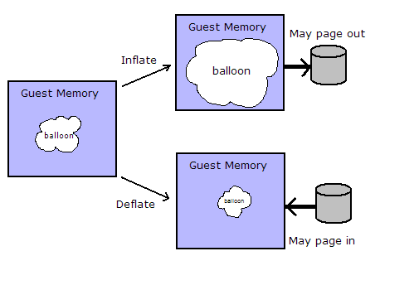
Ballooning – a neat trick!
ESX must do the memory reclamation with no information from VM OS
ESX uses Ballooning to achieve this
A balloon module or driver is loaded into VM OS
The balloon works on pinned physical pages in the VM
“Inflating” the balloon reclaims memory
“Deflating” the balloon releases the allocated pages

Slide 56
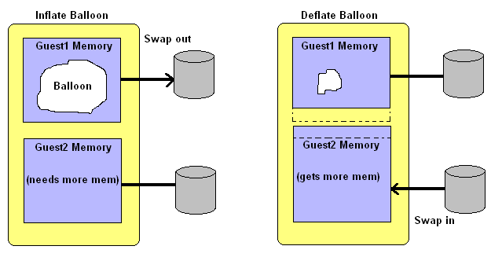
Ballooning – a neat trick!
Example of how Ballooning can be employed
ESX server can “coax” a guest OS into releasing some memory

Slide 57
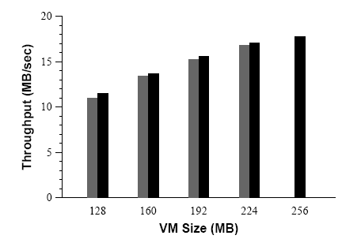
Ballooning - performance
Throughput of a Linux VM running dbench with 40 clients. The black bars plot the performance when the VM is configured with main memory sizes ranging from 128 MB to 256 MB. The gray bars plot the performance of the same VM configured with 256 MB, ballooned down to the specified size.

Slide 58
Ballooning - limitations
Ballooning is not available all the time: OS boot time, driver explicitly disabled
Ballooning does not respond fast enough for certain situations
Guest OS might have limitations to upper bound on balloon size
ESX Server preferentially uses ballooning to reclaim memory. However, when ballooning is not possible or insufficient, the system falls back to a paging mechanism. Memory is reclaimed by paging out to an ESX Server swap area on disk, without any guest involvement.

Slide 59
Sharing Memory - Page Sharing
Running multiple OSs in VMs on the same machine may result in multiple copies of the same code and data being used in the separate VMs. For example, several VMs are running the same guest OS and have the same apps or components loaded.
ESX Server can exploit the redundancy of data and instructions across several VMs
Multiple instances of the same guest OS share many of the same applications and data
Sharing across VMs can reduce total memory usage
Sharing can also increase the level of over-commitment available for the VMs

Slide 60
Page Sharing
ESX uses page content to implement sharing
ESX does not need to modify guest OS to work
ESX uses hashing to reduce scan comparison complexity
A hash value is used to summarize page content
A hint entry is used to optimize not yet shared pages
Hash table content have a COW (copy-on-write) to make a private copy when they are written too

Slide 61
Interposition with Memory Virtualization Page Sharing
VM1
VM2
Virtual
Virtual
Physical
Physical
Machine
Read-Only
Copy-on-write

Slide 62
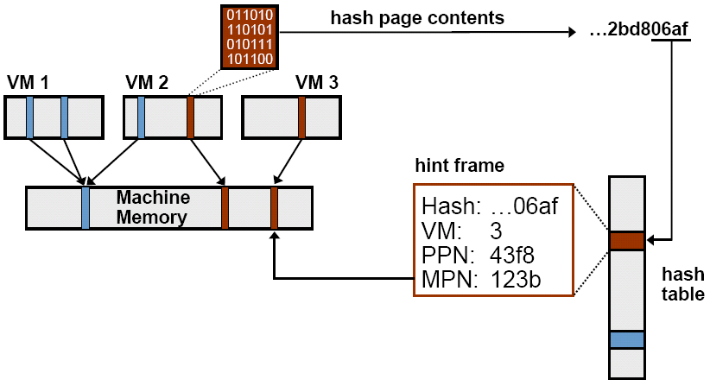
Page Sharing: Scan Candidate PPN

Slide 63
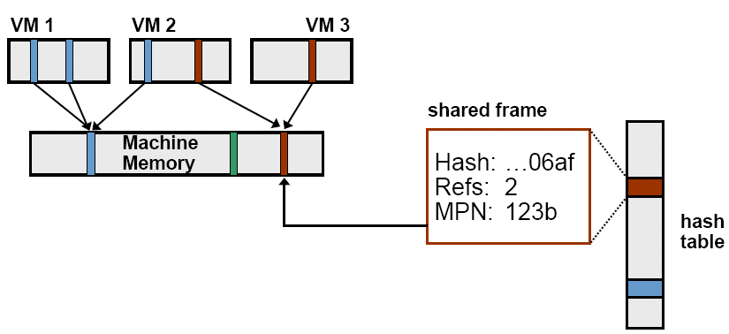
Page Sharing: Successful Match

Slide 64
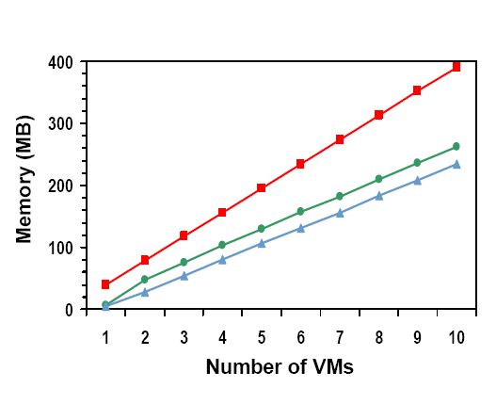
Page Sharing - performance
Best-case. workload.
Identical Linux VMs.
SPEC95 benchmarks.
Lots of potential sharing.
Metrics
Total guest PPNs.
Shared PPNs →67%.
Saved MPNs →60%.
Effective sharing
Negligible overhead

Slide 65
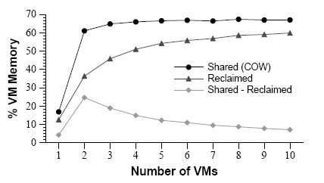
Page Sharing - performance
This graph plots the metrics shown earlier as a percentage of aggregate VM memory. For large numbers of VMs, sharing approaches 67% and nearly 60% of all VM memory is reclaimed.

Slide 66
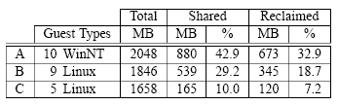
Page Sharing - performance
Real-World Page Sharing metrics from production deployments of ESX Server.
(A) 10 Win NT VMs serving users at a Fortune 50 company, running a variety of DBs (Oracle, SQL Server), web (IIS,Websphere), development (Java, VB), and other applications.
(B) 9 Linux VMs serving a large user community for a nonprofit organization, executing a mix of web (Apache), mail (Majordomo, Postfix, POP/IMAP, MailArmor), and other servers.
(C) 5 Linux VMs providing web proxy (Squid), mail (Postfix, RAV), and remote access (ssh) services toVMware employees.

Slide 67
Proportional allocation
ESX allows proportional memory allocation for VMs
With maintained memory performance
With VM isolation
Admin configurable

Slide 68
Proportional allocation
Resource rights are distributed to clients through shares
Clients with more shares get more resources relative to the total resources in the system
In overloaded situations client allocation degrades gracefully
Proportional-share can be unfair, ESX uses an “idle memory tax” to overcome this

Slide 69
Idle memory tax
When memory is scarce, clients with idle pages will be penalized compared to more active ones
The tax rate specifies the max number of idle pages that can be reallocated to active clients
When a idle paging client starts increasing its activity the pages can be reallocated back to full share
Idle page cost: k = 1/(1 - tax_rate) with tax_rate: 0 < tax_rate < 1
ESX statically samples pages in each VM to estimate active memory usage
ESX has a default tax rate of .75
ESX by default samples 100 pages every 30 seconds

Slide 70
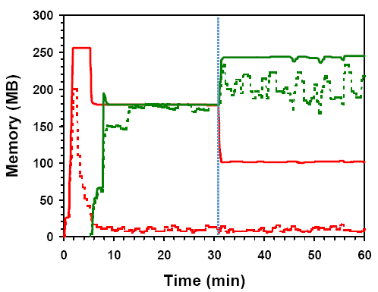
Idle memory tax
Experiment:
2 VMs, 256 MB, same shares.
VM1: Windows boot+idle. VM2:Linux boot+dbench.
Solid: usage, Dotted:active.
Change tax rate 0% → 75%
After: high tax.
Redistribute VM1→VM2.
VM1 reduced to min size.
VM2 throughput improves 30%

Slide 71
Dynamic allocation
ESX uses thresholds to dynamically allocate memory to VMs
ESX has 4 levels from high, soft, hard and low
The default levels are 6%, 4%, 2% and 1%
ESX can block a VM when levels are at low
Rapid state fluctuations are prevented by changing back to higher level only after higher threshold is significantly exceeded

Slide 72
I/O page remapping
IA-32 supports PAE to address up to 64GB of memory over a 36bit address space
ESX can remap “hot” pages in high “physical” memory addresses to lower machine addresses

Slide 73
Conclusion
Key features
Flexible dynamic partitioning
Efficient support for overcommitted workloads
Novel mechanisms
Ballooning leverages guest OS algorithms
Content-based page sharing
Proportional-sharing with idle memory tax

Slide 74
Overview
Virtualization and VMs
Processor Virtualization
Memory Virtualization
I/O Virtualization
Resource Management

Slide 75
Virtualized Resource Management
Physical resources
Actual “host” hardware
Processors, memory, I/O devices, etc.
Virtual resources
Virtual “guest” hardware abstractions
Processors, memory, I/O devices, etc.
Resource management
Map virtual resources onto physical resources
Multiplex physical hardware across VMs
Manage contention based on admin policies

Slide 76
Resource Management Goals
Performance isolation
Prevent VMs from monopolizing resources
Guarantee predictable service rates
Efficient utilization
Exploit undercommitted resources
Overcommit with graceful degradation
Support flexible policies
Meet absolute service-level agreements
Control relative importance of VMs

Slide 77
Resource Controls
Useful features
Express absolute service rates
Express relative importance
Grouping for isolation or sharing
Challenges
Simple enough for novices
Powerful enough for experts
Physical resource consumption vs. application-level metrics
Scaling from single host to cloud

Slide 78
VMware Basic Controls
Shares
Specify relative importance
Entitlement directly proportional to shares
Abstract relative units, only ratios matter
Reservation
Minimum guarantee, even when system overloaded
Concrete absolute units (MHz, MB)
Admission control: sum of reservations ≤ capacity
Limit
Upper bound on consumption, even if underloaded
Concrete absolute units (MHz, MB)

Slide 79
Shares Examples
Change shares for VM
Dynamic reallocation
Add VM, overcommit
Graceful degradation
Remove VM
Exploit extra resources

Slide 80
Reservation Example
Total capacity
1800 MHz reserved
1200 MHz available
Admission control
2 VMs try to power on
Each reserves 900 MHz
Unable to admit both
VM1 powers on
VM2 not admitted
VM1
VM2

Slide 81
Limit Example
Current utilization
1800 MHz active
1200 MHz idle
Start CPU-bound VM
600 MHz limit
Execution throttled
New utilization
2400 MHz active
600 MHz idle
VM prevented from using idle resources
VM

Slide 82
VMware Resource Pools
Motivation
Allocate aggregate resources for sets of VMs
Isolation between pools, sharing within pools
Flexible hierarchical organization
Access control and delegation
What is a resource pool?
Named object with permissions
Reservation, limit, and shares for each resource
Parent pool, child pools, VMs

Slide 83
Resource Pools Example
Admin manages users
Policy: Alice’s share is 50% more than Bob’s
Users manage own VMs
Not shown: resvs, limits
VM allocations:
Admin
300 Admin
200 Admin
Alice
Bob
75 Alice
75 Alice
400 Bob
30%
VM1
VM2
VM3
40%
30%

Slide 84
Example: Bob Adds VM
Same policy
Pools isolate users
Alice still gets 50% more than Bob
VM allocations:
Admin
300 Admin
200 Admin
Alice
Bob
30%
13%
75 Alice
75 Alice
400 Bob
800 Bob
VM1
VM2
VM3
VM4
27%
30%

Slide 85
Resource Controls: Future Directions
Application-level metrics
Users think in terms of transaction rates, response times
Requires detailed app-specific knowledge and monitoring
Can layer on top of basic physical resource controls
Other controls?
Real-time latency guarantees
Price-based mechanisms and multi-resource tradeoffs
Emerging DMTF standard
Reservation, limit, “weight” + resource pools
Authors from VMware, Microsoft, IBM, Citrix, etc.

Slide 86
Processor Scheduling
Useful features
Accurate rate-based control
Support both UP and SMP VMs
Exploit multi-core, multi-threaded CPUs
Grouping mechanism
Challenges
Efficient scheduling of SMP VMs
VM load balancing, interrupt balancing
Cores/threads may share cache, functional units
Lack of control over µarchitectural fairness
Proper accounting for interrupt-processing time

Slide 87
VMware Processor Scheduling
Scheduling algorithms
Rate-based controls
Hierarchical resource pools
Inter-processor load balancing
Accurate accounting
Multi-processor VM support
Illusion of dedicated multi-processor
Near-synchronous co-scheduling of VCPUs
Support hot-add VCPUs
Modern processor support
Multi-core sockets with shared caches
Simultaneous multi-threading (SMT)

Slide 88
Proportional-Share Scheduling
Simplified virtual-time algorithm
Virtual time = usage / shares
Schedule VM with smallest virtual time
Example: 3 VMs A, B, C with 3 : 2 : 1 share ratio
A
2
4
4
6
8
8
8
10
10
B
3
3
6
6
6
9
9
9
12
C
6
6
6
6
6
6
12
12
12

Slide 89
Hierarchical Scheduling
Admin
Motivation
Enforce fairness at each resource pool
Unused resources flow to closest relatives
Approach
Maintain virtual time at each node
Recursively choose node with smallest virtual time
vtime = 2000
vtime = 2100
Alice
Bob
vtime = 2200
vtime = 1800
vtime=2100
vtime = 2200
VM1
VM2
VM3
VM4
flow unused time

Slide 90
Inter-Processor Load Balancing
Motivation
Utilize multiple processors efficiently
Enforce global fairness
Amortize context-switch costs
Preserve cache affinity
Approach
Per-processor dispatch and run queues
Scan remote queues periodically for fairness
Pull whenever a physical CPU becomes idle
Push whenever a virtual CPU wakes up
Consider cache affinity cost-benefit

Slide 91
Co-Scheduling SMP VMs
Motivation
Maintain illusion of dedicated multiprocessor
Correctness: avoid guest BSODs / panics
Performance: consider guest OS spin locks
VMware Approach
Limit “skew” between progress of virtual CPUs
Idle VCPUs treated as if running
Deschedule VCPUs that are too far ahead
Schedule VCPUs that are behind
Alternative: Para-virtualization

Slide 92
Charging and Accounting
Resource usage accounting
Pre-requisite for enforcing scheduling policies
Charge VM for consumption
Also charge enclosing resource pools
Adjust accounting for SMT systems
System time accounting
Time spent handling interrupts, BHs, system threads
Don’t penalize VM that happened to be running
Instead charge VM on whose behalf work performed
Based on statistical sampling to reduce overhead

Slide 93
Processor Scheduling: Future Directions
Shared cache management
Explicit cost-benefit tradeoffs for migrations e.g. based on cache miss-rate curves (MRCs)
Compensate VMs for co-runner interference
Hardware cache QoS techniques
Power management
Exploit frequency and voltage scaling (P-states)
Exploit low-power, high-latency halt states (C-states)
Without compromising accounting and rate guarantees

Slide 94
NUMA Scheduling
NUMA platforms
Non-uniform memory access
Node = processors + local memory + cache
Examples: IBM x-Series, AMD Opteron, Intel Nehalem
Useful features
Automatically map VMs to NUMA nodes
Dynamic rebalancing
Challenges
Tension between memory locality and load balance
Lack of detailed counters on commodity hardware

Slide 95
VMware NUMA Scheduling
Periodic rebalancing
Compute VM entitlements, memory locality
Assign “home” node for each VM
Migrate VMs and pages across nodes
VM migration
Move all VCPUs and threads associated with VM
Migrate to balance load, improve locality
Page migration
Allocate new pages from home node
Remap PPNs from remote to local MPNs (migration)
Share MPNs per-node (replication)

Slide 96
NUMA Scheduling: Future Directions
Better page migration heuristics
Determine most profitable pages to migrate
Some high-end systems (e.g. SGI Origin) had per-page remote miss counters
Not available on commodity x86 platforms
Expose NUMA to guest?
Enable guest OS optimizations
Impact on portability

Slide 97
Summary
Resource management
Controls for specifying allocations
Processor, memory, NUMA, I/O, power
Tradeoffs between multiple resources
Distributed resource management
Rich research area
Plenty of interesting open problems
Many unique solutions

Slide 98
CPU Resource Entitlement
Resources that each VM “deserves”
Combining shares, reservation, and limit
Allocation if all VMs full active (e.g. CPU-bound)
Concrete units (MHz)
Entitlement calculation (conceptual)
Entitlement initialized to reservation
Hierarchical entitlement distribution
Fine-grained distribution (e.g. 1 MHz at a time), preferentially to lowest entitlement/shares
Don’t exceed limit
What if VM idles?
Don’t give VM more than it demands
CPU scheduler distributes resources to active VMs
Unused reservations not wasted

Slide 99
Example: Xen VM
Xen: Open-source System VMM for 80x86 ISA
Project started at University of Cambridge, GNU license model
Original vision of VM is running unmodified OS
Significant wasted effort just to keep guest OS happy
“paravirtualization” - small modifications to guest OS to simplify virtualization
3 Examples of paravirtualization in Xen:
To avoid flushing TLB when invoke VMM, Xen mapped into upper 64 MB of address space of each VM
Guest OS allowed to allocate pages, just check that didn’t violate protection restrictions
To protect the guest OS from user programs in VM, Xen takes advantage of 4 protection levels available in 80x86
Most OSes for 80x86 keep everything at privilege levels 0 or at 3.
Xen VMM runs at the highest privilege level (0)
Guest OS runs at the next level (1)
Applications run at the lowest privilege level (3)

Slide 100
Xen and I/O
To simplify I/O, privileged VMs assigned to each hardware I/O device: “driver domains”
Xen Jargon: “domains” = Virtual Machines
Driver domains run physical device drivers, although interrupts still handled by VMM before being sent to appropriate driver domain
Regular VMs (“guest domains”) run simple virtual device drivers that communicate with physical devices drivers in driver domains over a channel to access physical I/O hardware
Data sent between guest and driver domains by page remapping

Slide 101
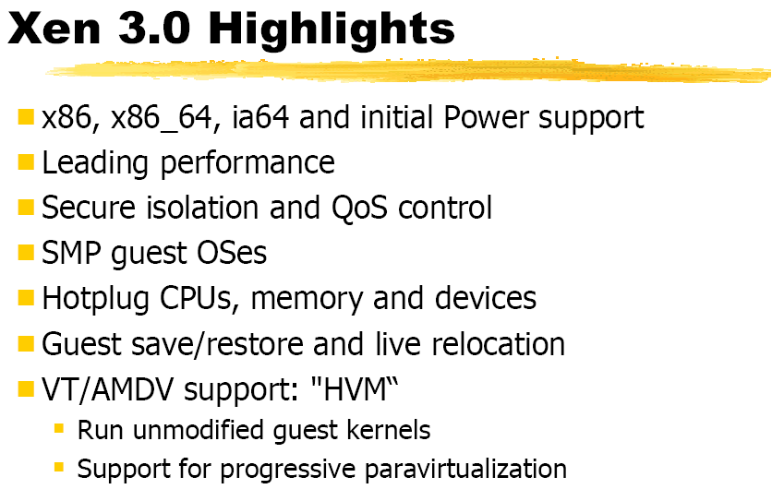
Xen 3.0

Slide 102
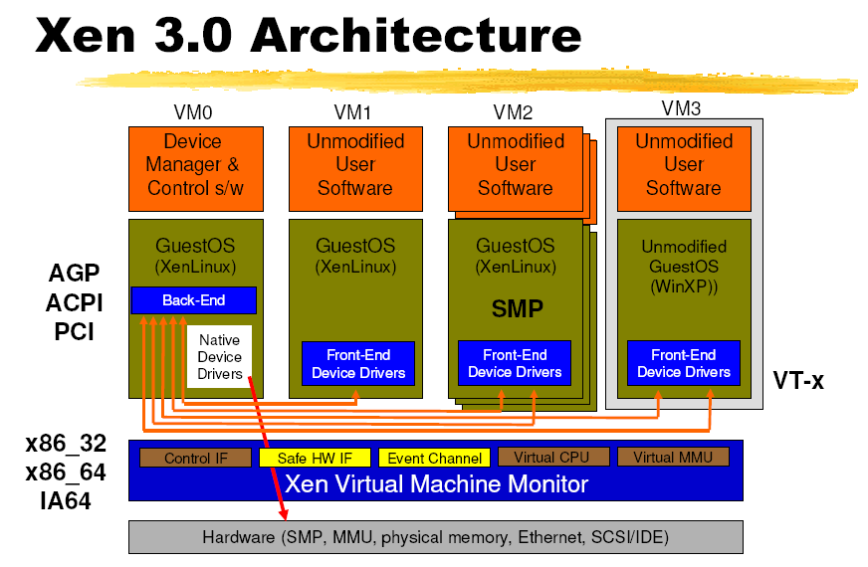
Xen 3.0

Slide 103
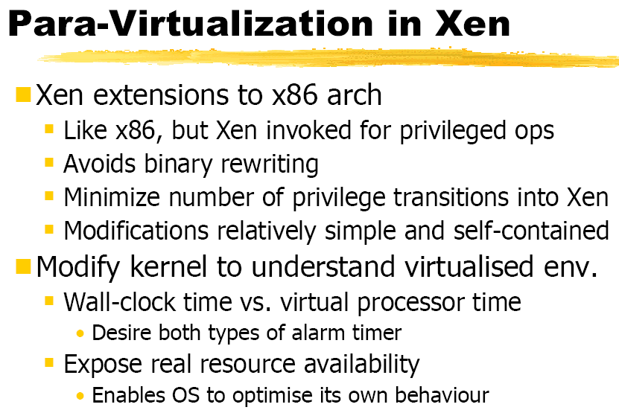
Xen 3.0

Slide 104
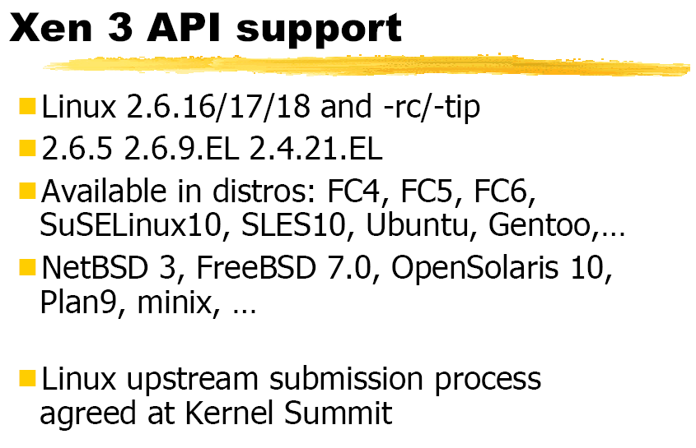
Xen 3.0

Slide 105
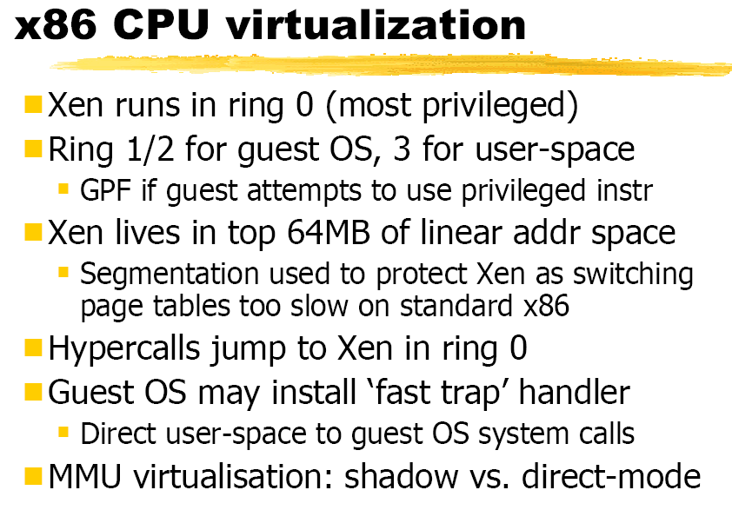
Xen 3.0

Slide 106
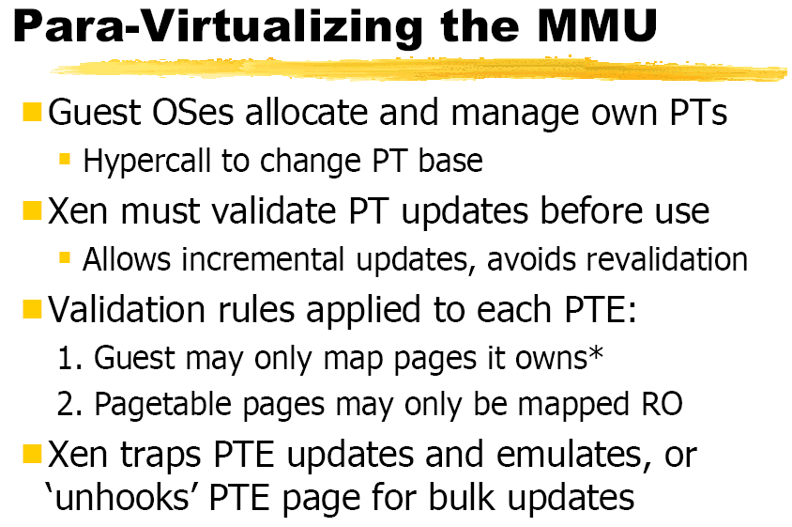
Xen 3.0

Slide 107
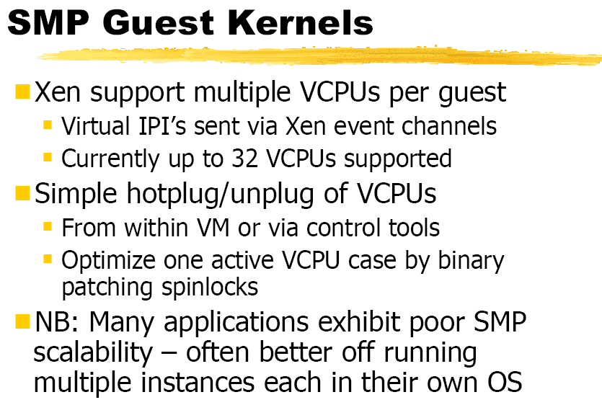
Xen 3.0

Slide 108
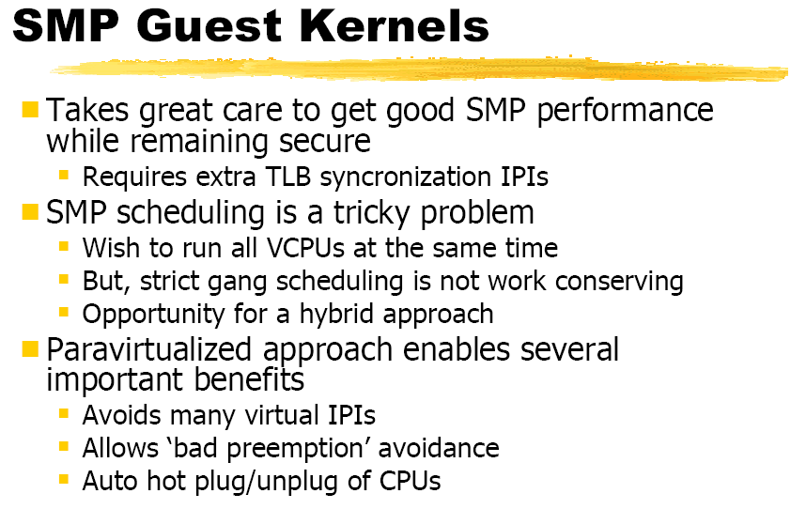
Xen 3.0

Slide 109
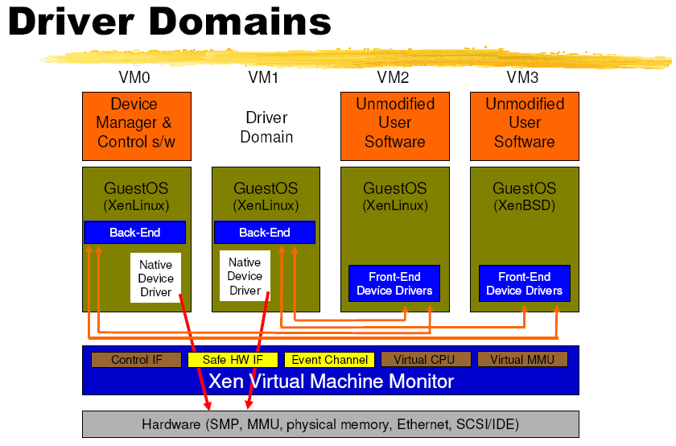
Xen 3.0

Slide 110
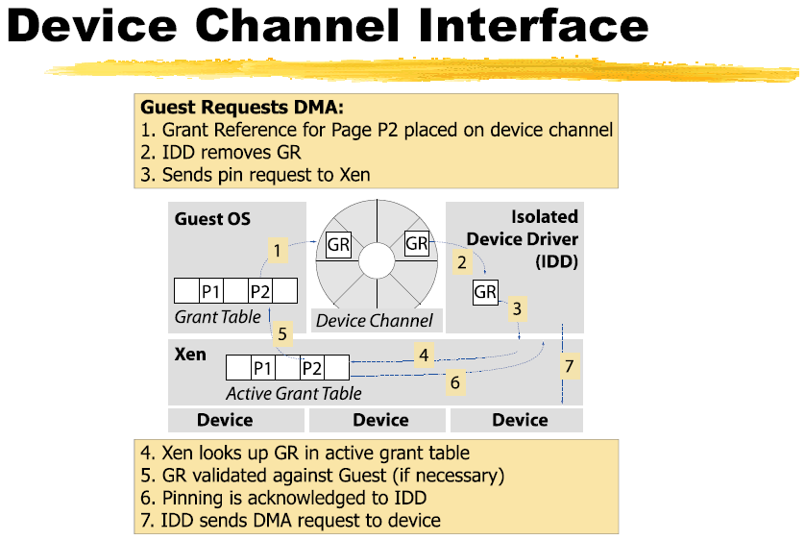
Xen 3.0

Slide 111
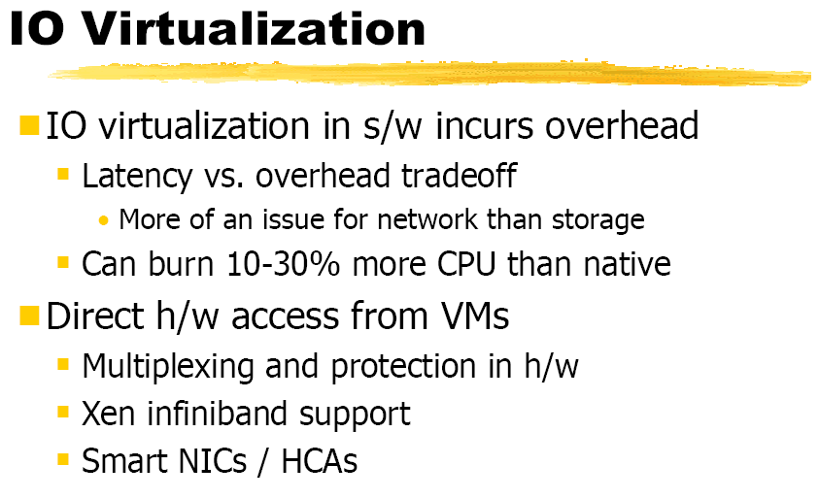
Xen 3.0

Slide 112
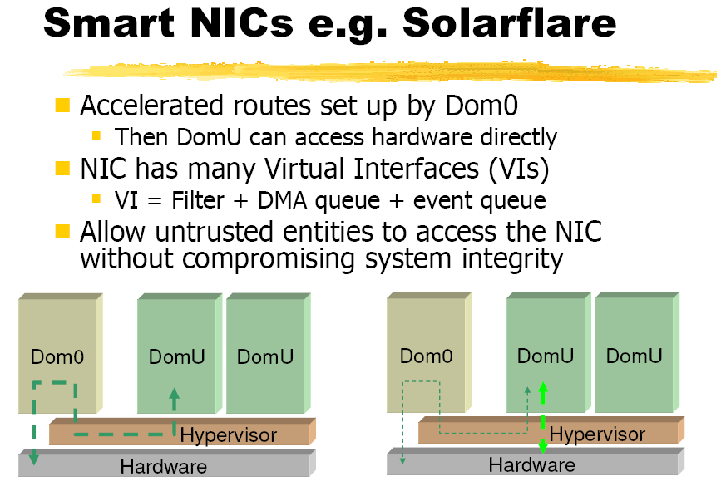
Xen 3.0

Slide 113
Xen Performance
Performance relative to native Linux for Xen for 6 benchmarks from Xen developers
Notes:
User-level processor-bound programs? I/O-intensive workloads? I/O-Bound I/O-Intensive

Slide 114
Xen Performance, Part II
Subsequent study noticed Xen experiments based on 1 Ethernet network interfaces card (NIC), and single NIC was a performance bottleneck

Slide 115
Xen Performance, Part III
> 2X instructions for guest VM + driver VM
> 4X L2 cache misses
12X – 24X Data TLB misses

Slide 116
Xen Performance, Part IV
> 2X instructions: page remapping and page transfer between driver and guest VMs and due to communication between the 2 VMs over a channel
4X L2 cache misses: Linux uses zero-copy network interface that depends on ability of NIC to do DMA from different locations in memory
Since Xen does not support “gather DMA” in its virtual network interface, it can’t do true zero-copy in the guest VM
12X – 24X Data TLB misses: 2 Linux optimizations
Superpages for part of Linux kernel space, and 4MB pages lowers TLB misses versus using 1024 4 KB pages. Not in Xen
PTEs marked global are not flushed on a context switch, and Linux uses them for its kernel space. Not in Xen
Future Xen may address 2. and 3., but 1. inherent?

